Slide 1



What is new in the Global Fund’s Grant Cycle 7 (GC7)?
Preparing for the 2023-2025 Allocation Cycle

Slide 2
Key changes in the Global Fund’s latest grant cycle (GC7)
Strategic opportunities to engage in key areas relating to HIV, health systems and community leadership
Minimum expectations for community engagement
Focus on gender equality
Timeline
CONTENTS

Slide 3
  I. Key changes in GC7 –
  the Global Fund’s latest grant cycle
  A. Programme essentials

Slide 4
Programme essentials help guide country prioritisation
New Programme Essentials have been introduced in GC7 to describe what elements are expected to be included in national programs supported by the Global Fund. ​
The Programme Essentials are critical interventions that are needed to achieve global targets on HIV, TB and Malaria.
They have a strong focus on human rights and gender and community responses.

Slide 5
  Programme essentials - HIV
* New elements are highlighted in red
1. HIV primary prevention | Condoms and lubricants are available for all people at increased risk of HIV infection Pre-exposure prophylaxis (PrEP) is available to all people at increased risk of HIV infection, and post-exposure prophylaxis (PEP) is available for those eligible. Harm reduction services are available for people who use drugs. Voluntary medical male circumcision (VMMC) is available for adolescent boys (15+ years) and men in high HIV incidence settings
2. HIV testing & diagnosis | HIV testing services include HIV self-testing, safe ethical partner and social network-based testing ​ A three-test algorithm is followed for rapid diagnostic test-based diagnosis of HIV ​ Rapid diagnostic tests are conducted by trained and supervised lay providers ​in addition to health professionals
3. Elimination of vertical transmission | Antiretroviral treatment (ART) is available for pregnant and breastfeeding women living with HIV to ensure viral suppression HIV testing, including early infant diagnosis (EID) is available for all HIV-exposed infants
4. HIV treatment & care | Rapid ART initiation follows a confirmed HIV diagnosis for all people irrespective of age, sex or gender. HIV treatment uses WHO recommended regimens. Management of advanced HIV disease is available. Support is available to retain people across the treatment cascade including return to care. CD4 and viral load testing, and diagnosis of common comorbidity and co-infections are available for management of HIV

Slide 6
  Programme essentials cont. - HIV
* New elements are highlighted in red
5. TB/HIV | People living with HIV with active tuberculosis (TB) are started on ART early TB preventive therapy is available for all eligible people living with HIV including children and adolescents ​​​
6. Differentiated service delivery (DSD) | HIV services (prevention, testing, treatment and care) are available in health facilities, including sexual and reproductive health services, and outside health facilities including through community, outreach, pharmacy and digital platforms. Multi-month dispensing is available for ART and other HIV commodities
7 .Human Rights | HIV programs for key and vulnerable populations integrate interventions to reduce human rights- and gender-related barriers. Stigma and discrimination reduction activities for people living with HIV and key populations are undertaken in health care and other settings. Legal literacy and access to justice activities are accessible to people living with HIV and key populations. Support is provided to efforts, including community-led efforts, to analyse and reform criminal and other harmful laws, policies and practices that hinder effective HIV responses

Slide 7
  I. Key changes in GC7 –
  the Global Fund’s latest grant cycle
  A. Programme essentials
  B. Information Notes

Slide 8
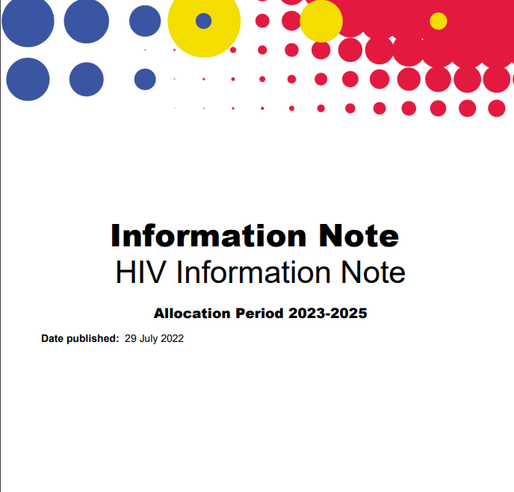
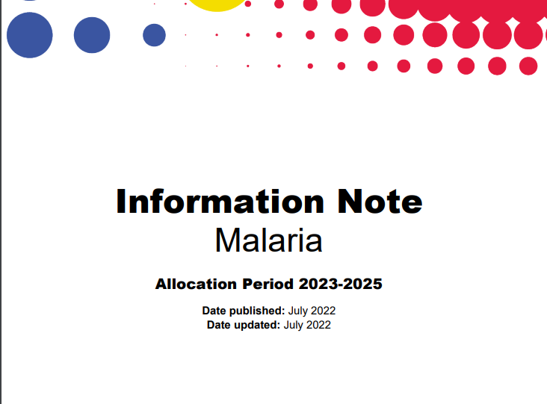
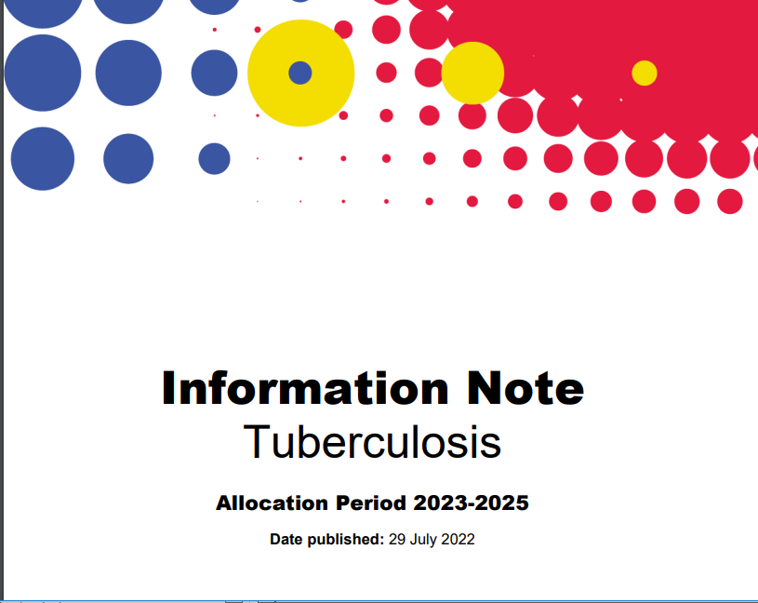
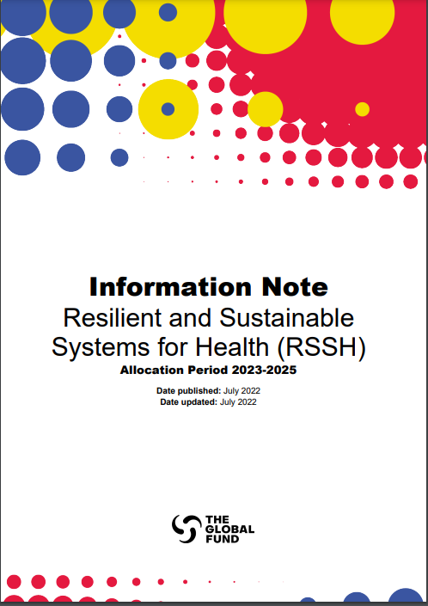
Information Notes on HIV, TB, Malaria and Resilient and Sustainable Systems for Health (RSSH) have been published
Available for download on the Global Fund website
Click to download!

Slide 9
  I. Key changes in GC7 –
  the Global Fund’s latest grant cycle
  A. Programme essentials
  B. Information Notes
  C. Modular Framework

Slide 10
The Modular Framework
The Framework focuses on 4 key areas​
HIV
The Global Fund have written a Modular Framework Handbook – it includes standard modules, interventions and performance indicators to support the development of funding request to the Global Fund. It can be found at:
TB
Malaria
Resilient and Sustainable Systems for Health
https://www.theglobalfund.org/media/4309/fundingmodel_modularframework_handbook_en.pdf

Slide 11

Overview of modules and interventions on HIV
Prevention
Differentiated HIV Testing Services
Elimination of vertical transmission of HIV, syphilis and hepatitis B
Treatment, care and support
One testing module that includes a combination of service delivery modalities and programs, namely
Facility testing
Community testing
Self-testing
In programs
KPs programs (not disaggregated)
AGYW programs
Non KPs/Non AGYW programs
Testing of pregnant women for HIV, HBV, syphilis
HIV prevention for HIV negative pregnant and breastfeeding women
Post-natal infant prophylaxis
Early infant diagnosis and follow-up HIV testing for exposed infants
Retention support for pregnant and breastfeeding women (facility and community)
HIV treatment and differentiated service delivery
Adults (15 and above)
Children (under 15)
Treatment monitoring - Drug resistance
Treatment monitoring - Viral load and ARV toxicity
Integrated management of common co-infections co-morbidities (adults and children)
Diagnosis and management of advanced disease (adults and children)
Condom and lubricant programing
Pre-exposure prophylaxis programming
HIV prevention communication: information and demand creation
Sexual and reproductive health services, including STIs, HBV, post-violence care
Harm reduction
Community empowerment
Removing human rights-related barriers to prevention
For PUD (injecting and non-injecting)
Needle and Syringe programs, incl. HBV and HCV
Opioid substitution therapy and other medically assisted drug dependence treatment
Overdose prevention and management
Specific to AGYW & MSP in high incidence settings
Social protection interventions
CSE for AGYW and ABYM
Voluntary Medical Male Circumcision
TB/HIV
TB/HIV collaborative activities
Screening, testing and diagnosis
Treatment
Prevention
Community TB/HIV care delivery
TB Key populations
Cross-cutting Modules
(i.e. RSSH, Program Management, Reducing Human right related barriers to HIV/TB services)

Slide 12
RSSH Modules and interventions
Modules | Interventions
RSSH: Health sector planning and governance for integrated people-centered services | Health sector planning and governance for integrated people centered services Integration/coordination across disease programs and at service delivery level Supporting private sector engagement
RSSH: Community systems strengthening | Community-led monitoring Community-led research and advocacy Community engagement, linkages and coordination Capacity building and leadership development
RSSH: Health Financing Systems | Health financing strategies and planning Public financial management systems Routine financial management systems Community led advocacy and monitoring of domestic resource mobilization Social Contracting Health financing data and analytics Blended Financing Arrangements
RSSH: Health Products Management Systems | Policy, strategy, governance Storage and distribution capacity, design & operations Planning and procurement capacity Regulatory/quality assurance support Avoidance, reduction and management of health care waste Supply chain information systems Augmenting national supply chain system with outsourcing

Slide 13
RSSH Modules and interventions
Modules | Interventions
RSSH/PP: Human resources for health and quality of care | HRH planning, management and governance including for community health workers (CHWs) Education and production of new health workers (excluding CHWs) Remuneration & deployment of existing/new staff (excluding CHWs) In-service training (excluding CHWs) Integrated supportive supervision for health workers (excluding CHWs) Quality improvement and capacity building for quality of care Community health workers: selection, pre-service training and certification Community health workers: contracting, remuneration and retention Community health workers: In-service training Community health workers: Integrated supportive supervision
RSSH/PP: Laboratory systems | National laboratory governance and management structures Quality management systems and accreditation Laboratory Information systems Network optimization and geospatial analysis Laboratory based surveillance Laboratory supply chain systems Specimen referral and transport system Biosafety and biosecurity, infrastructure and equipment management

Slide 14
  II. Strategic opportunities to engage in key areas relating to:
  A. HIV
  B. Health Systems
  C. Community Leadership

Slide 15
Key changes / new emphasis provide opportunities for engagement on HIV …
Stronger focus on HIV prevention - differentiated for scale, expanding coverage and improving quality
Integration of SRH/STI and HIV services
Strengthened platforms for delivery to expand options (PrEP, condoms, DPV rings) AND ways of delivering services (community-led, virtual, pharmacy etc.)
Prioritise people living with HIV across their life-course and populations with the highest risk and vulnerability to HIV
Greater emphasis on data for decision-making, incl. community participatory needs assessment and community-led monitoring
Move away from “behavioral interventions” to health communication and demand creation
Addressing chemsex
Click to download!
Continued emphasis on community-led, community-based programmes, addressing human rights- and gender-related barriers to services and Community System strengthening

Slide 16
… and system strengthening
Community-led programming is essential to achieve objectives
Integrate community health strategies as part of national disease response
Support policy advocacy, reform and innovative sustainability mechanisms to enable community-led groups and networks to provide peer-led services, particularly where key populations face substantial barriers to accessing services
Scale and integrate CHW programmes
Make interventions more people-centered with explicit emphasis on community-led initiatives, strengthen community engagement, linkages and coordination; capacity building and leadership development
More tailored activities including: differentiated capacity building; support for legal registration and safe operations of community-led organisations; emphasis on institutionalising CLM data/feedback for data driven decision making
Click to download!

Slide 17
Emphasis on community-led monitoring and data for decision-making
Activities led and implemented by local community-led organisations to improve accessibility, acceptability, affordability, quality and impact of health services. For example:
Development of national community-led monitoring frameworks and strategies for public health facilities, private facilities and in community-based settings (e.g., observatories, alert systems, scorecards etc.)
Community-led monitoring of barriers to accessing services.
Piloting new community-led monitoring mechanisms and programs for learning and improvement.
Tools and equipment including appropriate technologies for data management and storage.
Technical support and training: e.g. development of data collection tools, data cleaning and analysis, using community data to inform decision-making and advocacy, informed consent, ethics approval, etc.
Presentation and discussion of community-led monitoring data and recommendations in various governance structures, oversight mechanisms and other decision-making fora.
Click to download!

Slide 18
Guidance on service delivery arrangements
CLOs/CBOs are well placed to deliver the following services in the HIV-specific programmes:
HIV
Prevention | Delivery of commodities, behavioral interventions, services for KPs, incl. harm reduction and peer-based services, integration of HIV into SRHR services
Testing | Community-based testing, counselling, peer support (e.g. home testing), linkage
Treatment | Education/literacy, peer navigation, adherence support, loss-to-follow up
Demand creation | Awareness raising, demand generation, address gender norms
Care and support | Psychosocial support, care for families, economic empowerment
Rights and legal services | Stigma reduction programs, GBV prevention and response, paralegal services, legal and human rights literacy
Sensitisation | Healthcare personnel, lawmakers, law enforcement officials
*Note - other pillars of community responses, incl. activities related to advocacy, participation in accountability, CLMs, participatory community research and community resource mobilisation – should all be community-led

Slide 19
  III. Minimum expectations for community engagement
  A. The Global Fund context
  B. Minimum expectations

Slide 20
Community Engagement in the Global Fund context
The leadership of communities living with and most affected by the three diseases is central to the Global Fund. Communities playing a central role in its governance at country and global levels, as implementors, in accountability, and as advocates for its mission.
Extensive evidence on the importance of community engagement and the connection between communities engaged in decisions that impact on their lives, trust between communities and other actors in health responses, and the effectiveness of interventions, programs and systems that are responsive to actual and changing needs.
The Global Fund’s goals and mission outlined in the Global Fund Strategy 2023-2028 commits to: “a stronger role and voice for communities living with and affected by the diseases, reinforcing this unique strength of the Global Fund and tackling barriers to effective participation and leadership, to put the most affected communities at the center of everything we do.”
Click to download!

Slide 21
Minimum Expectations for community engagement
The minimum expectations for community engagement across the full grant cycle are:
    Funding Request and Allocation Letter: A transparent and inclusive consultation process with populations most impacted by the three diseases during funding request leading to the development of an “Annex of Funding Priorities of Civil Society and Communities Most Affected by HIV, TB and Malaria”
    Grant Making: Community and civil society representatives on the CCM have timely access to information on status of grant negotiations and changes to the grant to support their involvement in oversight
    Grant Implementation: Community and civil society representatives on the CCM have timely access to information on program implementation
Click to download!

Slide 22
  IV. Gender Equality
  A. The Global Fund strategy

Slide 23
Gender equality - Action from the Global Fund
STRENGTHENED funding request requirements: applicants required to demonstrate in greater detail how they have identified gender-related barriers, why they exist, how they impact on health outcomes, and how they are addressed in the funding request
NEW gender assessment tools: applicants provided examples of tools to help complete and use gender assessments. Gender assessments will be submitted alongside funding request
NEW Gender Equality Marker. All funding requests scored against gender-equality criteria relating to program design, implementation and evaluation
STRENGTHENED community engagement, including from women and gender-diverse communities, through minimum expectations at three stages across grant lifecycle
STRENGTHENED gender risk management: more comprehensive definitions, root causes and capacity assessment tool
NEW mid year evaluation: to assess how GF’s actions are translating into gender-responsive programming
NEW: two gender-equality KPIs for assurance and accountability
Funding Request
Grant-making
Grant implementation
RETAINED CCM requirements on representation from women, girls and gender-diverse communities
RETAINED gender technical brief: made more user-friendly
RETAINED: gender equality in TRP assessment criteria
RETAINED: Country support for implementation from CRG technical experts
RETAINED: provide/broker quality TA, including through Strategic Initiatives
RETAINED: support uptake and use of community-based monitoring
RETAINED: KPI on data disaggregation

Slide 24
  V. Timeline
  A. What next?

Slide 25
Key Dates
The next grant cycle runs from 2023 to 2025.
Countries are invited to apply for new grants during one of four windows in 2023.
Countries can choose which window to apply in and additional windows will be added – see here for latest information:
https://www.theglobalfund.org/en/applying-for-funding/design-and-submit-funding-requests/timing-of-submissions/
Click to download!

Slide 26
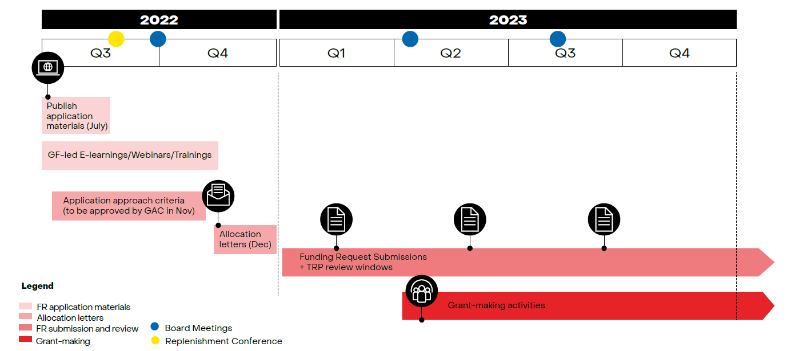
Timeline
Click to download!

Slide 27
Further Info
To find out more or for guidance on how to engage with GC7 processes contact:
Saima Jiwan
sjiwan@gnpplus.net
Click to download!

