Slide 1





National UHC Training

Slide 2
Welcome & Introductions
Let's get started!

Slide 3
1
To create UHC champions within national HIV networks and communities
Purpose of the Training
To promote universal health coverage policies that are equitable, inclusive and supportive of a fully-funded comprehensive approach to HIV
2

Slide 4
Ground Rules

Slide 5
Introduction to UHC

Slide 6
1
What is UHC?
2
National health insurance
Agenda
3
National health policy and plans
4
Role of Civil Society in UHC
5
Key UHC Resources

Slide 7
Describe UHC in simple language
Recognise and understand key UHC concepts and terminology
Learning Objectives
After completing this session, you will be able to:
Understand the linkages between HIV and UHC
Know where to go for information on UHC

Slide 8
What is UHC?

Slide 9
Discussion
What does the term 'universal health coverage' mean to you?

Slide 10
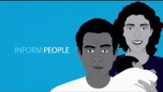
Video
Notes:
https://youtu.be/pZHiIGFLN8Y

Slide 11
WHO Definition of UHC
  UHC means that all individuals and communities receive the health services they need without suffering financial hardship.
  It includes the full spectrum of essential, quality health services, from health promotion to prevention, treatment, rehabilitation, and palliative care.
  UHC enables everyone to access the services that address the most significant causes of disease and death and ensures that the quality of those services is good enough to improve the health of the people who receive them.
- World Health Organisation

Slide 12
SDG3: Good Health and Wellbeing
Ensure health lives and promote well-being for all at all ages
Target 3.3:
By 2030, end the epidemics of AIDS, Tuberculosis, malaria and neglected tropical diseases and combat hepatitis, water-borne diseases and other communicable diseases
Target 3.8:
Achieve universal health coverage, including financial risk protection, access to quality essential health-care services and access to safe, effective, quality and affordable essential medicines and vaccines for all

Slide 13
UN Political Declaration on UHC, 2019
1
We, Heads of State and Government and representatives of States and Governments, assembled at the United Nations on 23 September 2019, with a dedicated focus for the first time on universal health coverage… strongly recommit to achieve universal health coverage by 2030, with a view to scaling up the global effort to build a healthier world for all, and in this regard we:
2
9. Recognize that universal health coverage implies that all people have access, without discrimination, to nationally determined sets of the needed promotive, preventive, curative, rehabilitative and palliative essential health services, and essential, safe, affordable, effective and quality medicines and vaccines, while ensuring that the use of these services does not expose the users to financial hardship, with a special emphasis on the poor, vulnerable and marginalized segments of the population;
Notes:
Every country in the world has pledged to ensure that all people and all communities receive the health services they need without financial hardship by 2030.
This goal is known as universal health coverage. Countries are free to decide how they will achieve this.

Slide 14
What is financial hardship?
1
Extreme poverty is defined as living on 1.90 USD or less a day
3
Over 930 million people (around 12% of the world’s population) spend more than 10% of their household budgets to pay for health care
According to WHO, 100 million people are pushed into extreme poverty each year because of health costs
This is known as ‘Catastrophic Health Expenditure’
2
4
Notes:
Financial hardship caused by health costs is one of the major reasons why there is a global movement for UHC. This is when a person or family has to pay so much money ‘out of pocket’ for healthcare that they are left with very little money to survive on.
100 million people are pushed into extreme poverty each year because of health costs - unexpected illness requires them to use up their life savings, sell assets, or borrow money.
This is one of the key reasons behind the push for universal health coverage.

Slide 15
Key Term: Out of Pocket (OOP)
Direct payments made by individuals to health care providers at the time of health service use:
  User fees
  Co-payments
  Prescription/medication charges
  Clinic charges
  Lab tests
  Gloves etc
  Immunisation fees
  Unofficial charges (bribes)
Notes:
Many countries have traditionally relied on citizens paying for their own healthcare to supplement health budgets.
Here are some examples of health expenses you have to pay out of your own pocket. Can you add any more?
These OOP payments are known to increase health inequities because the poorest and sickest are impacted by them the most. To ensure equity in UHC, these payments must be reduced to a minimum.
In some countries people prefer to go to private clinics to ensure confidentiality and privacy, even if free government services are available.

Slide 16
Should healthcare be free for everyone?
Discussion Point
What could be the problems with this approach?
Notes:
What would it mean to make healthcare available to everyone for free and what might the problems be?

Slide 17
Quiz
What does your government spend on health?

Slide 18
Spending on health per person 2018 (USD)
Government Spending on Health
750
500
250
0
1
2
3
4
5
Notes:
Country 1 = Senegal
Country 2 = Ghana
Country 3 = Ukraine
Country 4 = Indonesia
Country 5 = Cote D’Ivoire

Slide 19

Break Time

Slide 20
National Health Policies

Slide 21
National health insurance
1
2
3
A system of insurance that insures a national population against the costs of health care
May be administered by the public sector, the private sector, or a combination of both
Funding mechanisms vary with the particular program and country
4
5
6
Sometimes funded by general taxation, e.g. Medicare Australia; National Health Service UK; National Health Insurance Service South Korea
Sometimes called statutory health insurance (SHI)
Usually established by national legislation

Slide 22
Is there a national health insurance scheme in your country?
Discussion
Are there community-based schemes?
Notes:
Ghana: NHIS
Indonesia: JKN
Senegal: No
Cote D’Ivoire: No
Ukraine: No – but it is a proposal
Community-based health insurance schemes are common in low-income countries. They usually offer a basic health package for a flat rate. However, the user still needs to pay for the services not covered and the poorest and most vulnerable will still be excluded

Slide 23
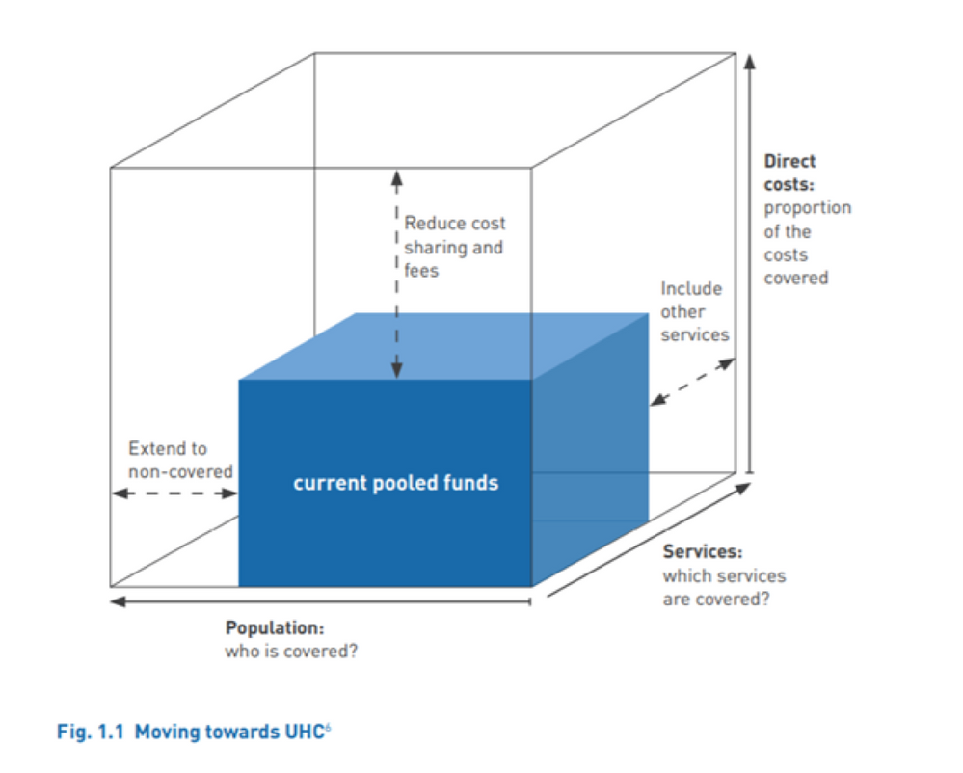
Funds available
Three Dimensions of UHC
Notes:
Something you will come across if you work on UHC is this cube diagram.
Universal health coverage aims to make improvements in three key areas:
o Higher numbers of people accessing health services
o An expanded range of health services available
o Removal or reduction of health fees and treatment costs
Governments generally need to make changes in all three dimensions to improve health coverage, although they may focus on one area more than others depending on resources available.
The blue small cube is the money you have available to spend. The three dimensions are:
• Height = costs
• Width = population
• Depth = services

Slide 24
Quiz
What is your national health policy called?
Notes:
How do you find out about your government’s plans for health and UHC?
It is the National Health Policy, National Health Strategy or Plan that sets out government policy on health, including plans for health reform and UHC goals.
These plans should set out how governments will allocate domestic resources efficiently and fairly, and how they will fund national health coverage.
Ghana = National Health Policy 2020-2030
Ukraine = National Health Reform Strategy 2015-2020
Indonesia = Ministry of Health Strategic Plan 2015-2019
Senegal = Plan National de Developpement Sanitair 2009-2018
Cote D’Ivoire = Plan National de Developpement Sanitaire 2016-2020

Slide 25
Essential Health Service Packages
1
Governments have to decide on which services are essential to meet the basic health needs of the population and what they will pay for
When making these decisions they have to consider:
  Equity – ensuring equal and fair access to services
  Disease burden profile – the main health needs of the population
  Cost-effectiveness – aiming to achieve the greatest impact given the available resources
2
3
Sometimes referred to as a Minimum Health Benefit Package
Notes:
The national health policy or plan should be where the government sets out which services it will provide to people under the health insurance or health system.
There are three things that governments have to consider:
o Equity – ensuring equal and fair access to services
o Disease burden profile – the main health needs of the population (most serious causes of disease and death)
o Cost-effectiveness

Slide 26

Video
Notes:
https://youtu.be/XM-X4fQHsW0

Slide 27
What services do you think should be in a basic national health package?
Discussion Point

Slide 28

Lunch

Slide 29
1
Give a lot of people a little - 100% of the population have access to one or two free basic services (e.g. doctor consultation, immunisation) but everything else has to be paid for
Poll: What would you do?
2
Give a few people a lot - certain groups within the population (e.g. children, over 80s) everything for free but everyone else has to pay
3
Make everyone pay a percentage of their income (e.g. 10%) each year regardless of their health needs
Notes:
You are the Minister of Health in your country. You need to choose one of the three options. What would you choose?

Slide 30
The Role of Civil Society in UHC
1
All countries have committed to engage with civil society in the development, implementation and evaluation of health policies (2019 Declaration paragraph 54)
2
WHO recommends that national citizen/population consultations take place at the start of the health policy planning cycle, so the results can feed into the development of any new national health policy or strategy.
3
Governments often undertake a health sector situation analysis when starting a new health policy or strategy. WHO recommends that this process is participatory and inclusive
4
Civil society should have a seat at the decision-making table (as with CCMs)

Slide 31
The Civil Society Engagement Mechanism for UHC2030
1
CSEM is the civil society section of UHC2030 working to ensure that UHC policies are inclusive and equitable, and that systematic attention is given to the most marginalised and vulnerable populations so that no one is left behind
2
Aims:
  Inclusive and broad advocacy movement on UHC/HSS
  UHC policy and implementation that meets the needs of vulnerable and marginalised people
  Stronger citizen/community-led accountability mechanisms
  Greater coordination and harmonisation of civil society advocacy on health
  https://csemonline.net/about-us/

Slide 32
1
Includes all components of the health system: health service delivery systems, the health workforce, health facilities and communications networks, health technologies, information systems, quality assurance mechanisms, health financing and governance and legislation.
2
Is more than just health insurance schemes
3
Does not mean free coverage for all possible health interventions, regardless of the cost
UHC
4
Is not only about ensuring a minimum package of health services, but also about ensuring a progressive expansion of coverage of health services and financial protection as more resources become available
5
Includes public health measures, for example adding fluoride to water

Slide 33
Key Resources on UHC
Notes:
Pass around the Resources Sheet

Slide 34



Evaluation
Notes:
What I liked
What I was inspired by
Questions I still have

Slide 36
Welcome & Introductions
Let's get started!

Slide 37
1
Re-cap - What is UHC?
2
Video
3
Introduction to UHC Advocacy
Linkages between HIV and UHC
4
UHC and you
5
Where to start
6
Advocacy strategy

Slide 38
Explain why UHC is important for HIV advocacy and programming
Understand how your work can contribute to UHC design and implementation
Learning Objectives
After completing this session, you will be able to:
Know where to start advocacy on UHC, who your allies are and who to target
Deliver key messages on UHC to your community and policy-makers

Slide 39
Re-cap: What is UHC?

Slide 40
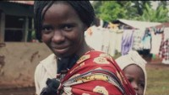
Video
Notes:
https://youtu.be/C1bIjISMlTo

Slide 41
Reminder
  Every country in the world has pledged to achieve UHC by 2030
  UHC looks different in different countries
  UHC is more than health insurance
  There are many different aspects to UHC (services, finance, governance, accountability)
  The goal of ending AIDS and the goal of UHC are closely linked

Slide 42
HIV & UHC

Slide 43
1
Not possible to deliver one without the other
2
Leave no one behind
HIV and UHC: Common goals & values
Human rights principles: equity, non-discrimination, dignity, social justice
3
4
Sustainable, predictable resources for health
5
COVID-19: role of health systems
Notes:
The goals of achieving UHC and ending the AIDS epidemic are complementary and one cannot be achieved without the other. The underlying values and principles are the same: equity, non-discrimination, dignity, and social justice.
In 2019, less than half of key populations were reached with combination HIV prevention services in more than half of the countries that reported to UNAIDS.
New health funding from domestic sources for UHC could help close the HIV financing gap and improve sustainability.

Slide 44
Is it possible to advocate for UHC and for HIV at the same time?
Discussion Point

Slide 45
UNAIDS
  Essential high-impact HIV interventions need to be defined and integrated into the national health benefit package
  This package needs to be adapted and delivered equitably to all populations in need
  The national health financing system should cover the costs of HIV services to minimize OOP expenditure and risk of financial hardship

Slide 46
Why engage with UHC?
1
All countries are pursuing health reforms to achieve UHC
These health reforms could fundamentally change how healthcare is funded, designed and delivered
2
UHC has a strong focus on integration of services – HIV services will be integrated into other health services
3
UHC has a strong focus on domestic financing for health – there may be less donor support for ARVs
4
UHC has a strong focus on health systems – the role of communities is not always clear
5

Slide 47

Break Time

Slide 48
HIV in UHC: Community Concerns
1
Less external donor support for HIV
2
Key populations are ineligible or excluded from national health insurance
Health systems approach will ignore non-health aspects of HIV e.g., stigma and discrimination
3
4
Community-led and rights-based approaches will be overlooked
Diminished support for tailored, stand-alone services and monitoring of service uptake for key and marginalised populations
5

Slide 49
UHC and You
PLHIV Networks have a lot to bring to UHC:
1
4
6
Lived experience
Experience of delivering people-centred health services
Commitment to equity, inclusiveness and human rights
2
Data (Stigma Index etc)
3
7
On the ground/frontline knowledge of connecting with broader health services (peer supporters)
5
Expertise on how to reach the most vulnerable and marginalised
Ability to advocate and hold decision-makers to account
Notes:
These are some of the many things you bring to the UHC discussion.
First of all you have lived experience of HIV and other health issues that are often connected so you can speak with authority about what this means and what works for you
You also have information and data about how the health system works or doesn’t work for people living with HIV - some of you have been involved in the Stigma Index in Cote D’Ivoire, Ukraine and Ghana
You have considerable expertise and experience in people-centered approaches, integrated services and especially on how to reach the most marginalized and vulnerable people
You have a strong commitment to human rights and inclusiveness and how to advocate for access to medicines and services, as well as to hold policymakers to account on their commitments

Slide 50
Where to start
Question
How to find the answer
Next Steps
1. Have there been any citizen/public consultations on UHC in your country?
  Consult MoH website
  Ask CSEM members
  Ask UNAIDS
If no, demand public consultation
2. Is there a governmental Technical Working Group on UHC or similar?
  Consult MoH website
  Ask CSEM members
  Ask UNAIDS
If yes, ask if civil society has a seat on it. If no, find out where UHC/health reforms are being discussed in government
3. Have there been any debates in Parliament on UHC?
  Consult Parliamentary record/reporting
  Ask your MP
If yes, find out which MPs spoke and what they said about it
4. Has legislation been passed on UHC/health reforms?
  Consult MoH website
  Ask your MP
If yes, what does it say about CS engagement and inclusion of KPs?

Slide 51
Where to start
Question
How to find the answer
Next Steps
  Consult the CSEM membership list - see next slide
  Ask your own network of contacts
Ask the CSOs working on UHC for the latest UHC information and if there are any advocacy strategies underway or planned and ask Questions 2 & 3
1. Are any CSOs working actively on UHC already?
2. Is there already a national level advocacy coalition working on UHC advocacy?
If yes, ask if you can join it
If no, ask if CSOs would be interested in a meeting on UHC
Ask Question 3
  As above
  Consult the Ministry of Health website
  Ask the Ministry of Health when the next opportunity for CSO engagement is
3. Is civil society engaged in UHC policy-making in your country?
If yes, find out who is engaged and how
If no, make this your first advocacy ask and recruit other CSOs to this agenda
Notes:
All governments have committed to involving civil society actively in UHC policy and implementation. Therefore, if you find that there has been no civil society engagement so far, this becomes your top advocacy goal. In most countries, there will be definitely room for improvement in terms of how communities and health networks are included.

Slide 52
Lunch

Slide 53
Advocacy Plan Template
Steps
Method
Advocacy plan
Situational analysis and problem definition
What needs to change?
Goals (asks)
Who can be your partners and allies?
Stakeholder analysis
Allies
Who can make that change and who do they listen to?
Power mapping
Targets
When is the best time to act?
Calendar
Key dates
What is the message?
Message framing
Key messages
Notes:
There are five main things you need to know in order to do effective advocacy.
The first thing is to identify the problem. What is the situation is with UHC and HIV in your own country?
Then you need to find out who your allies will be in solving the problem.
Thirdly you will need to do a power mapping. This is very important so that you do not waste time with the wrong targets!
Then you need to identify the key moments to act, for example when the budget is going through Parliament, or when a new national plan is being developed.
Finally, you need to develop the message to your targets. We will look at this in group work in a moment.

Slide 54
Advocacy Goals
1
Ensure and expand engagement of civil society and communities in the design, implementation and monitoring of UHC
2
Push the issue of domestic health financing and health reform higher up the government agenda (use COVID-19)
Ensure UHC strategies are truly universal, equitable and inclusive: put the last mile first/leave no one behind
3
Notes:
Do these work in our context? Do we need to refine them further?
You can decide which of them will be most important for you to push for in your first year, and which are more long-term goals.

Slide 55
Who has the power to make decisions on health?
Mini Power Mapping
Who do you know in government?
Notes:
Make two lists – one is a list of people that have the power to make decisions on health and budgets for health.
The second list is who people know in government.
Is there any overlap?

Slide 56
Group Work

Slide 57
Messaging Grid
Who to target
What to say
In what form
?
?
?
?
?
?
?
?
?
To meet the advocacy goals, who do you need to target, what do you need to say and in what method will you use to say it?
Notes:
You will now be divided into small groups to focus on a key target.
Group 1: Minister of Health
Group 2: Member of Parliament
Group 3: District Health Official
Group 4: Voters/general public
Group 5: NGOs working in other sectors, e.g. WASH, mental health, nutrition
What do these targets need to know about UHC?
To meet the advocacy goals, what do you need to say and what method will you use to say it.
In terms of method we mean the form you will use to communicate the message – social media, face to face meetings, briefing papers, twitter, letters, celebrities, etc
Use this grid to help you.
Each group needs to come back the message they want to communicate and the method they will use to reach the target.

Slide 58
Tactics to consider
Face to face meetings
Seminars
Press conferences
Twitter
Briefing papers
Celebrities/VIPs
Public protest/rally
Newspaper articles
Petitions
Letters
Parliament
Data
Notes:
Here are some tactics to consider as you do the group work.

Slide 59
What is the best way to reach the Minister of Health with your message?
What is the best way to reach a district health official with your message?
  Public protest?
  Newspaper article?
  Twitter?
  Face to face meeting?
  Briefing paper?
  Twitter?

Slide 60
What is the best way to reach an MP with your message?
When is the best time to reach an MP?
  When Parliament is in recess?
  When legislation is being debated?
  On a Tuesday?
  Newspaper article?
  Face to face meeting?
  Letters from constituents?

Slide 61
Advocacy Asks
1
Leave no one behind/Put the last mile first
  Inclusive and rights-based policies and legislation
2
Show us the money
  Invest more in health and social protection (COVID-19)
A seat at the table
  Greater involvement of civil society, key, marginalised and vulnerable groups
3
Better systems for health
  Scale up community-led approaches and support health workers
  Stop stigma and discrimination within health services
4
5
Include HIV in the health benefit package
Notes:
Here are some of the key messages that have already been developed in the UHC advocacy movement and by the HIV community.

Slide 62
Messaging Grid
Who to target
What to say
In what form
Voters
#healthforall
Twitter
Civil Society
The UHC we want
Meetings
MPs
Show us the money
Letters
Civil servants
Include civil society
Meetings
Minister of Health
Leave no one behind
Briefings (data)
Treasurer
No wealth without health
Briefings (data)
President
UHC by 2030
Celebrities/VIPs
Notes:
This is what a completed grid might look like.

Slide 63
Key Moments
National Elections
Health debates in Parliament
Annual Budget going though Parliament
New National Health Policy
Public consultations
World Health Day (7 April)
UHC Day (12 Dec)
Others?
Notes:
It is important to time your messaging!

Slide 64
Who are our allies on UHC?
Stakeholder Mapping
How can we work together?
Notes:
Finally, we need to talk about who we can join with in our advocacy. Who are the important stakeholders? How can we work together?

Slide 65
Advocacy Plan Template
Steps
Method
Advocacy plan
Situational analysis and problem definition
What needs to change?
Goals (asks)
Who can be your partners and allies?
Stakeholder analysis
Allies
Who can make that change and who do they listen to?
Power mapping
Targets
When is the best time to act?
Calendar
Key dates
What is the message?
Message framing
Key messages
Notes:
We have discussed what needs to change, who our allies can be, who we need to target, when and the messages. This all comes together in an advocacy plan.

Slide 66
Evaluation
Notes:
What I liked
What I was inspired by
Questions I still have

Slide 67

Thank you all for being part of Positive Universe and thank you RCF for supporting this work!

